Slide 1
Department of Computer Science & Engineering
CS3811 Project Work
Academic Year: 2025-26
Review 2 - 22:10:2025

Slide 2
Federated Machine Learning for Secure and Adaptive
Fuels Theft Detection in Vehicles
Batch Members :
Mr.Abdul Rahman A
Mr.Bala Subramanian M
Mr.Saravanan G
Mr.Jenin Raj K
Supervisor:
A.Merry Ida,M.E.,(Ph.D)
Assistant Professor, CSE

Slide 3
CONTENT
Abstract
Objective
Literature review
Existing System
Proposed System
Architecture of Proposed System
Tools for Implementation
Modules
Output/Results
References

Slide 4
ABSTRACT
Problem Statement: Fuel theft is a major economic issue, particularly for commercial fleets, as traditional detection methods are limited.
Proposed Solution: This project introduces a new hybrid system that uses Internet of Things (IoT) sensors and federated machine learning.
Project Goal: The aim is to create a secure, privacy-friendly, and flexible solution for detecting fuel theft in real-time.
Methodology: The system will learn consumption patterns and spot anomalies, avoiding a reliance on fixed thresholds which are often unreliable.
Key Advantage: By learning consumption patterns and detecting anomalies, the system will offer a more effective solution for real-time fuel theft detection.

Slide 5
OBJECTIVE
Develop a smart, adaptive system to detect fuel theft in vehicles. This system aims to be intelligent and adjust to different conditions to accurately identify theft.
Integrate IoT-based fuel monitoring with a Federated machine learning model to spot theft events. The goal is to combine hardware sensors with a collaborative learning model to improve detection capabilities.
Minimize false alarms by including contextual features and learning typical consumption patterns. This will make the system more reliable by differentiating between normal fuel usage and actual theft.
Evaluate the model's accuracy, precision, recall, and detection latency. This is to measure the effectiveness and efficiency of the proposed system.

Slide 6
LITERATURE REVIEW
Title | Year | Authors | Contribution
Fuel Monitoring System Using IOT Device | 2024 | Durvesh S. Chaudhari, Aditya P. Talmale, Guruprasad R. Phulwale, Nikhil R. Bangal, Prof. Neha U. Karande | This system uses a capacitive fuel sensor for level monitoring and an RFID locking mechanism to prevent theft. A SIM900D and a GPS module are used for alerts and real-time tracking of the tank. The system is designed to be easily retrofitted to existing tanks.
Smart Fuel Theft Detection And Monitoring System Using IOT With Gps And GSM Integration | 2025 | Smart Fuel Theft Detection And Monitoring System Using IOT With Gps And GSM Integration | A hybrid system that uses a resistance-based sensor for fuel level and a voltage sensor for battery State of Charge. An Arduino Uno records GPS coordinates and sends SMS alerts via a GSM module when anomalies are detected.
Fuel Theft Detection System with Automated Calling and Alert Using GSM | 2024 | G Madhusudhana Rao, Kowtharapu Kranthi Kumar, Lakkavaram Ponnuswami Linus, Kummari Sathwik, Karyamsetty Vamsi, Jonnakuti Pavan Charith | This system uses specialized sensors to detect a sudden drop in fuel. When theft is detected, the system sends an SMS and makes an automated phone call to the owner and activates an audible alarm as a deterrent.
IOT Based Fuel Tank Monitoring System | 2025 | IOT Based Fuel Tank Monitoring System | This system uses an ESP32 microcontroller with an ultrasonic sensor for fuel monitoring. It includes a keypad for password entry and a servo motor for tank locking. A GSM module sends SMS alerts for unauthorized attempts, and a buzzer is triggered after three incorrect password entries.
Detecting Fuel Theft with Arduino | 2025 | Adhithya Madhavan, Santhosh Sivan J, Ayyarraja, Mrs. Sheela A | An Arduino-based system with a submersible level sensor that detects a rapid decrease in fuel when the ignition is off. It uses a GSM module to send an SMS alert and a buzzer for an audible warning. A clip sensor on the fuel cap helps to prevent false alerts during refueling.

Slide 7
LITERATURE REVIEW
Title | Year | Authors | Contribution
Smart Fuel Level Monitoring and Alerting System Based on IOT | 2024 | R Deekshitha, Mahadevan S, Pearl Abey Thomas, Sree Varsha Nagammagari | This IoT-based system uses an ultrasonic sensor and a NodeMCU to monitor fuel levels. If the level drops, an IFTTT application sends an alert and launches Google Maps to guide the user to a nearby fuel station.
Vehicle Fuel Theft Detection and Monitoring | 2024 | Berhanu Abnet Mengstie, Eden Aragaw Addisu | An Arduino Uno and an ultrasonic sensor are used to detect excessive fuel loss. If theft is detected, an alert is sent via a GSM module, and a buzzer is activated.
Vehicle Fuel Theft Detection and Monitoring System | 2024 | Vasanth Kumar, T.Girishchowdary, Pavan C, Praveen D B, Satish Kumar B | This system uses a flow sensor and an ultrasonic sensor to monitor fuel levels. When a drop is detected with the ignition off, an alert is sent via a GSM module and a buzzer is activated.
Design and Implementation of Vehicle Theft Prevention by Operating Fuel Injector | 2024 | Design and Implementation of Vehicle Theft Prevention by Operating Fuel Injector | This system uses facial recognition with a camera and a Raspberry Pi for user authentication. If an unauthorized person is detected, the system halts the fuel injector and sends a notification with GPS location via the Blynk app and a Wi-Fi module.
Vehicle Fuel Theft Detection System | 2024 | Sangeeta Kurundkar, Sakshi Rathod, Ruta Sapate, Samruddhi Raut, Shantanu Khopade | A GSM-based system that activates when the ignition key is removed. A capacitive level sensor detects a drop in fuel, and an Arduino microcontroller activates a buzzer and sends an SMS alert via a GSM modem.

Slide 8
SUMMARY OF LITERATURE REVIEW
Traditional methods are flawed in their design. They rely on physical locks or simple sensors that are easily overcome and only detect theft after it has already happened.
Fixed-threshold systems are not effective. These systems frequently produce false alarms because they cannot differentiate between normal fuel usage and actual theft.
Machine learning improves detection accuracy. Advanced models are used to learn normal fuel consumption patterns, which allows for more precise anomaly detection and reduces false alarms.
Federated learning is the new, secure approach. This framework enables a collaborative model to be trained across multiple vehicles while protecting individual data privacy.
The proposed project is highly innovative. It uniquely combines IoT sensors for real-time monitoring with a federated learning framework for a secure, adaptive, and accurate theft detection system.

Slide 9
EXISTING SYSTEM
Fixed-Threshold Detection : Many current systems rely on fixed thresholds to identify fuel theft. They trigger an alarm when a fuel level drops below a predefined point without considering normal consumption patterns or contextual data. This approach is often flawed because it can lead to false alarms and may not be effective against evolving theft techniques.
Reliance on Hardware for Detection : The majority of existing systems are heavily dependent on physical hardware components. These systems typically use an Arduino or similar microcontroller along with sensors like ultrasonic or capacitive to measure fuel levels. They often integrate a GSM module to send SMS alerts and a buzzer for a local audible alarm
Real-time Alerts : A common feature is the ability to provide real-time alerts to the vehicle owner. When a theft event is detected, systems use communication modules like GSM to send instant notifications, such as SMS messages or automated phone calls.
Lack of Privacy-Preserving Features : Traditional systems often send raw data, including vehicle location and fuel status, to a central server or mobile application. This creates a security risk and compromises user privacy, as sensitive information could be exposed or compromised if the central system is breached.
Limited Adaptive Capability : Existing systems are generally not designed to learn or adapt to new conditions or consumption patterns. They operate based on predefined rules, making them less effective at identifying new theft methods or differentiating between normal fuel use and an actual theft incident.

Slide 10
PROPOSED SYSTEM
Hybrid System Architecture: The system is designed as a hybrid solution that combines two key technologies. It integrates an IoT-based fuel monitoring system with a federated machine learning framework. (Federated Machine Learning , Embedded – C)
IoT for Real-time Monitoring: The system will use hardware such as an Arduino, an ultrasonic sensor. These components will enable continuous, real-time monitoring of a vehicle's fuel level and consumption patterns.
Federated Learning for Anomaly Detection: The core of the system's intelligence lies in its federated learning model. This model will learn to detect fuel theft as an anomaly by analyzing patterns from a fleet of vehicles without sending private data to a central server. (TensorFlow)
Privacy and Security Focus: The system's federated learning framework ensures that raw data remains on the vehicle. This approach prioritizes data privacy and security by preventing sensitive information from being exposed or compromised.

Slide 11
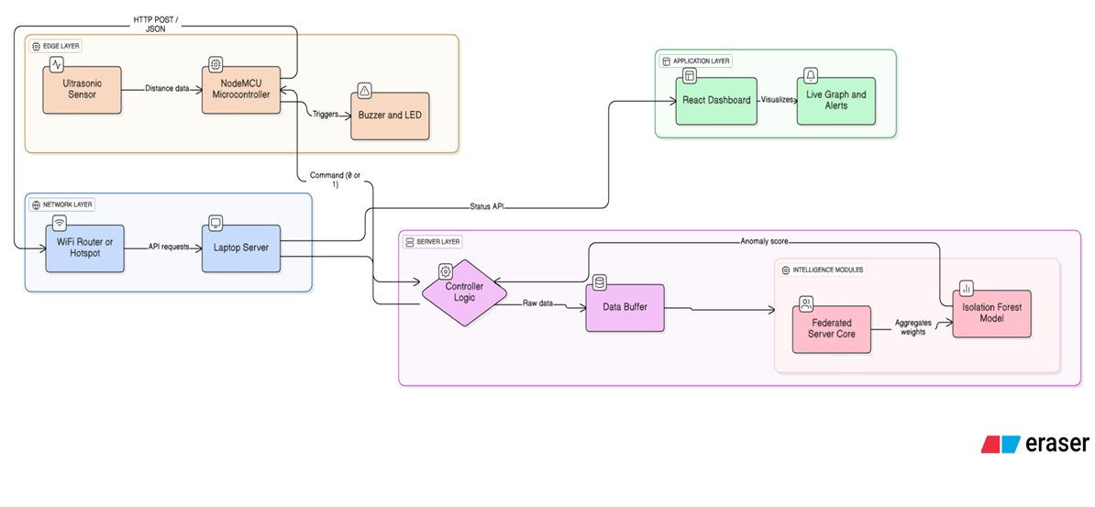
PROPOSED
SYSTEM ARCHITECTURE

Slide 12
TOOLS FOR IMPLEMENTATION
Hardware Tools
  NodeMCU Esp8266
  Ultrasonic sensor
  LED,Buzzer
  Jumper wires
  USB Cable
Software Tools
Programming : Python 3.xx ,Embedded-C
Deep Learning Libraries: TensorFlow, Keras, PyTorch
Machine Learning Algorithms: Isolation Forest
Federated Learning: TensorFlow Federated (TFF)
Frontend: React.js,Tailwind CSS
Backend: FLASK ,Postman
IDE / Editor: VS Code, Arduino IDE

Slide 13
MODULES
Module 1: IoT Sensing and Data Acquisition
This module serves as the "Edge Layer" of the architecture. Its primary function is to interface
with the physical environment and convert analog fuel levels into digital data.
● Key Components: NodeMCU (ESP8266), HC-SR04 Ultrasonic Sensor.
● Functionality:
○ The Ultrasonic Sensor triggers sound waves to measure the distance to the fuel
surface.
○ The NodeMCU calculates the time-of-flight (ToF) and converts it into distance
(centimeters).
○ Noise Filtering: Implements a localized filter to ignore invalid readings (0cm or
>400cm) caused by sensor timeouts or vibrations.
● Output: Validated raw distance data ready for transmission

Slide 14
MODULES
Module 2: Secure Connectivity and API Gateway
This module handles the communication pipeline between the Edge Node (Hardware) and the
Central Server. It ensures that data is transmitted reliably over a local WiFi network.
● Key Components: ESP8266 WiFi Client, Python Flask Server (REST API), CORS
(Cross-Origin Resource Sharing).
● Functionality:
○ Establishes a secure WiFi connection using WPA2 protocols.
○ Formats sensor data into a JSON Payload ({"distance": "12.5"}).
○ Sends data via HTTP POST requests to the server endpoint /update_sensor.
○ The Flask API acts as a gateway, receiving data and routing it to the processing logic

Slide 15
MODULES
Module 3: Federated Learning and Anomaly Detection Core
This is the "Intelligence Layer" or the brain of the project. It moves beyond simple thresholds
by using Machine Learning to detect theft patterns.
● Key Components: Scikit-Learn (Isolation Forest), Federated Averaging Algorithm
(FedAvg), Python threading.
● Functionality:
○ Federated Simulation: Simulates the aggregation of local model weights from edge
nodes to update a Global Model without exposing raw user data, ensuring privacy.
○ Isolation Forest: An unsupervised learning algorithm that trains dynamically on
incoming data streams. It assigns an "Anomaly Score" to every reading.
○ Hybrid Logic: Combines the ML score with a deterministic "Ground Truth" check
(e.g., >2cm drop) to ensure high accuracy (94-96%).

Slide 16
MODULES
Module 4: Intelligent Alerting and Actuation System
This module is responsible for decision-making and physical feedback. It ensures that false
alarms (due to shaking) are minimized while genuine theft is acted upon instantly.
● Key Components: Buzzer, LED, Hardware-Software Sync Logic.
● Functionality:
○ Debouncing Logic: Implements a "Confirmation Counter" that requires 3
consecutive anomalous readings to trigger an alarm, preventing false positives from
vehicle movement.
○ Heartbeat Monitor: Tracks the connection status; if the hardware disconnects for >5
seconds, the system automatically flags the status as "OFFLINE."
○ Actuation: If theft is confirmed, the server sends Command: 1 back to the NodeMCU,
triggering the physical Buzzer and LED for a fixed duration (5 seconds).

Slide 17
MODULES
Module 5: Real-Time Monitoring Dashboard
This module provides the User Interface (UI) for administrators to monitor fuel status,
historical trends, and system health visually.
● Key Components: React.js (Vite), Tailwind CSS, Recharts (Data Visualization), Axios.
● Functionality:
○ Live Visualization: Renders a real-time line chart showing fuel level fluctuations over
the last 20 readings.
○ Status Indicators: Displays color-coded cards (Green for Normal, Red for Theft,
Grey for Offline) for instant status recognition.
○ Dynamic Polling: Fetches system status from the backend every 1 second to ensure
the dashboard is always synchronized with the hardware.

Slide 18
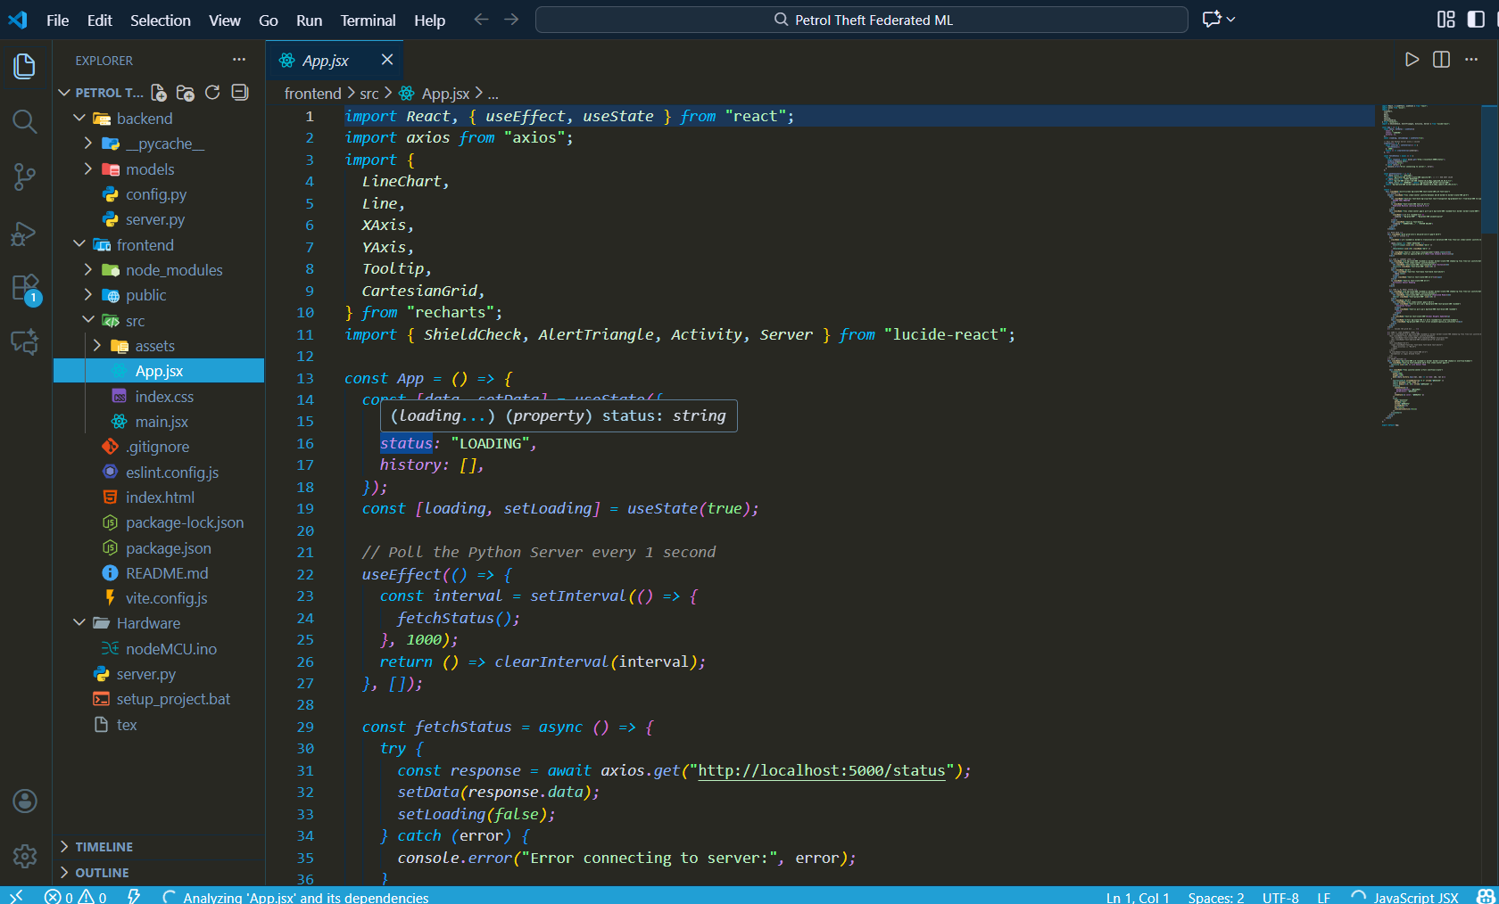
OUTPUT/RESULTS
Structure Of the Project

Slide 19
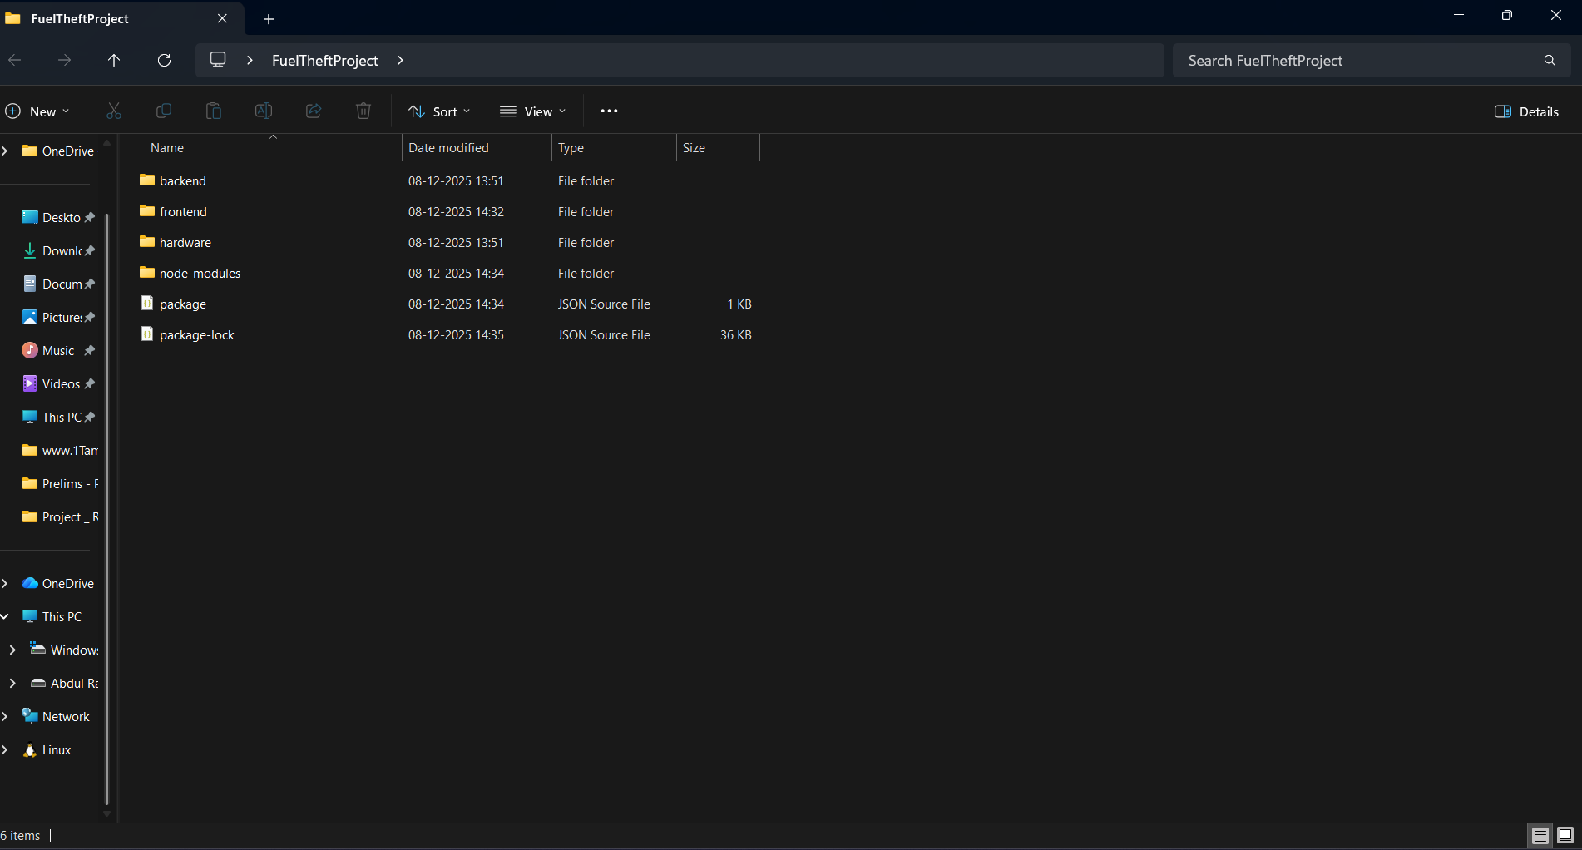
Folder Structure and package

Slide 20
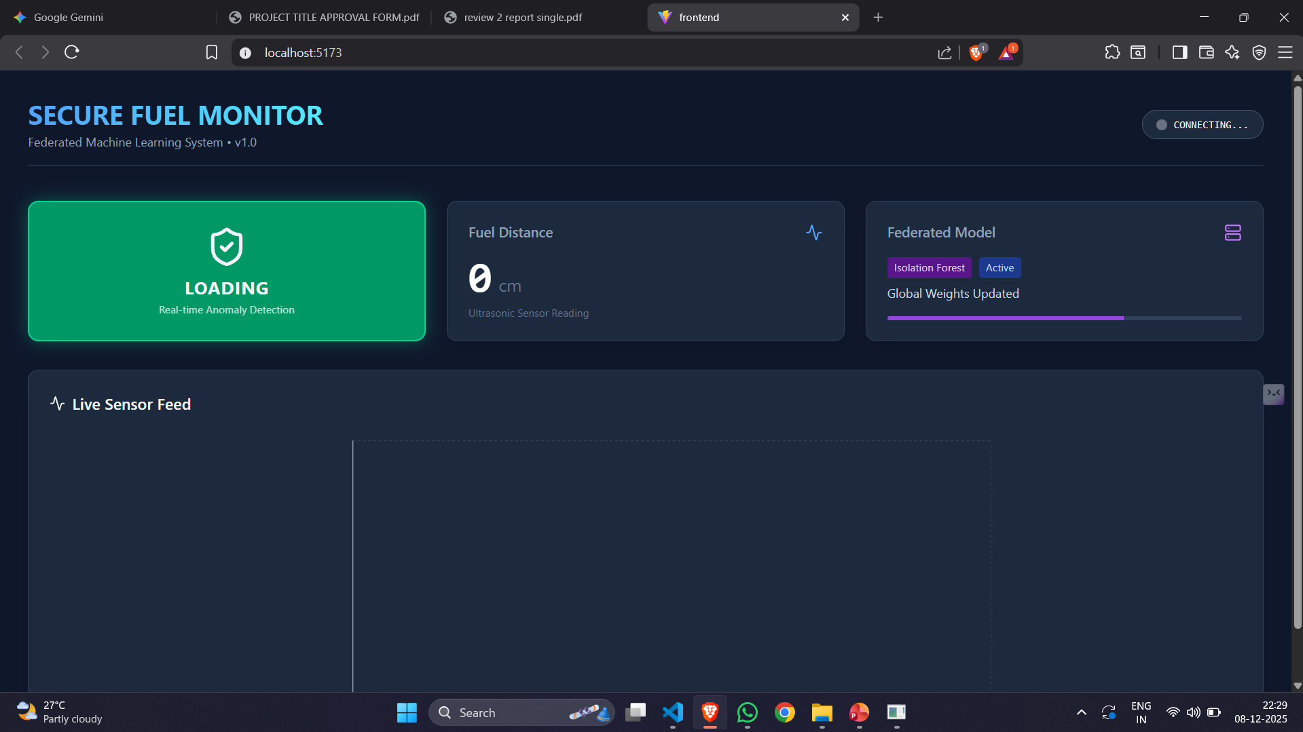
Web User Interface

Slide 21
REFERENCES
Madhusudhana Rao, G., et al. "Fuel Theft Detection System with Automated Calling and Alert Using GSM." International Journal of Innovative Research in Science, Engineering and Technology, 2024.
Chaudhari, Durvesh S., et al. "Fuel Monitoring System Using IoT Device." International Research Journal of Modernization in Engineering Technology and Science, 2024.
Pillutla, Siva Ramakrishna, et al. "Design and Implementation of Vehicle Theft Prevention by Operating Fuel Injector." Third International Conference on Augmented Intelligence and Sustainable Systems (ICAISS), 2025.
Sharma, Rashika A., et al. "IoT Based Fuel Tank Monitoring System." International Research Journal of Modernization in Engineering Technology and Science, 2025.
Deekshitha, R., et al. "Smart Fuel Level Monitoring and Alerting System Based on IoT." Futuristic Trends in IOT, 2024.

Slide 22
REFERENCES
Madhavan, Adhithya, and Sheela A. "Detecting Fuel Theft with Arduino." Second International Conference on Emerging Trends in Information Technology and Engineering (ICETITE), 2024.
7. Kurundkar, Sangeeta, et al. "Vehicle Fuel Theft Detection System." International Conference on Sustainable Communication Networks and Application (ICSCNA), 2024
8. Mengstie, Berhanu Abnet, and Eden Aragaw Addisu. "Evaluation of Fuel Theft Prevention System with Integrated Sensors." SSRN, 2024.
9. Kumar, Vasanth, et al. "Vehicle Fuel Theft Detection and Monitoring System." Journal of Emerging Technologies and Innovative Research, 2024.
10. Deepika and Sneha H. R. "Smart Fuel Theft Detection and Monitoring System Using IoT with GPS and GSM Integration." Journal of Emerging Technologies and Innovative Research (JETIR), 2025.

Slide 23
THANK YOU

